Slide 1
MAPPING SUSCEPTIBILITY TO LANDSLIDES Logistic Regression Method
EXERCISE 2
CHUKWU CHINYERE PRECIOUS

Slide 2
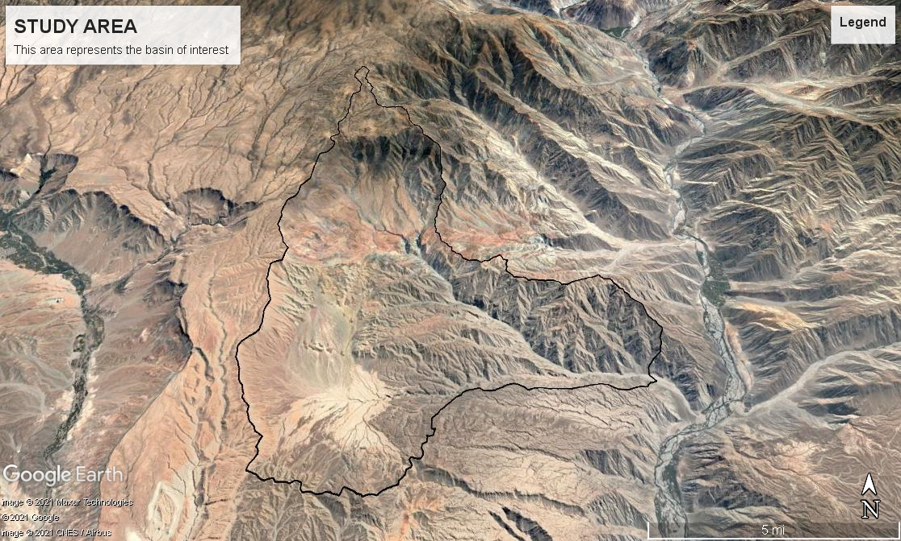

Slide 3
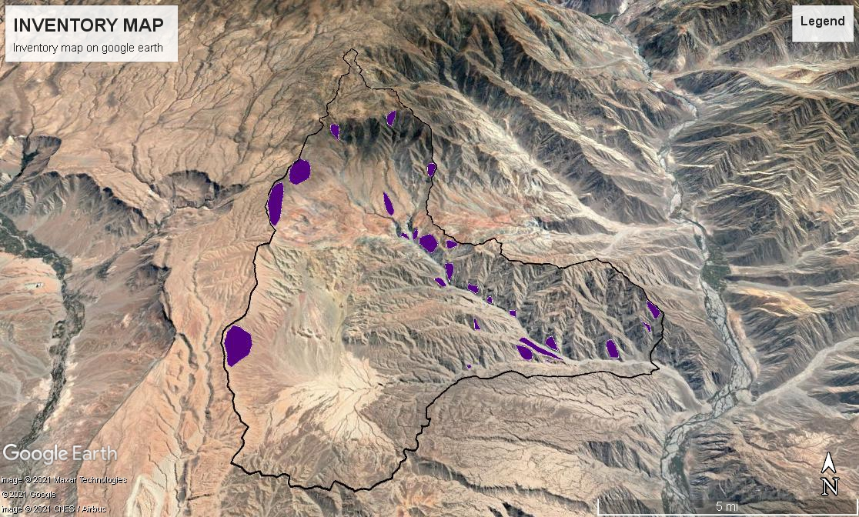
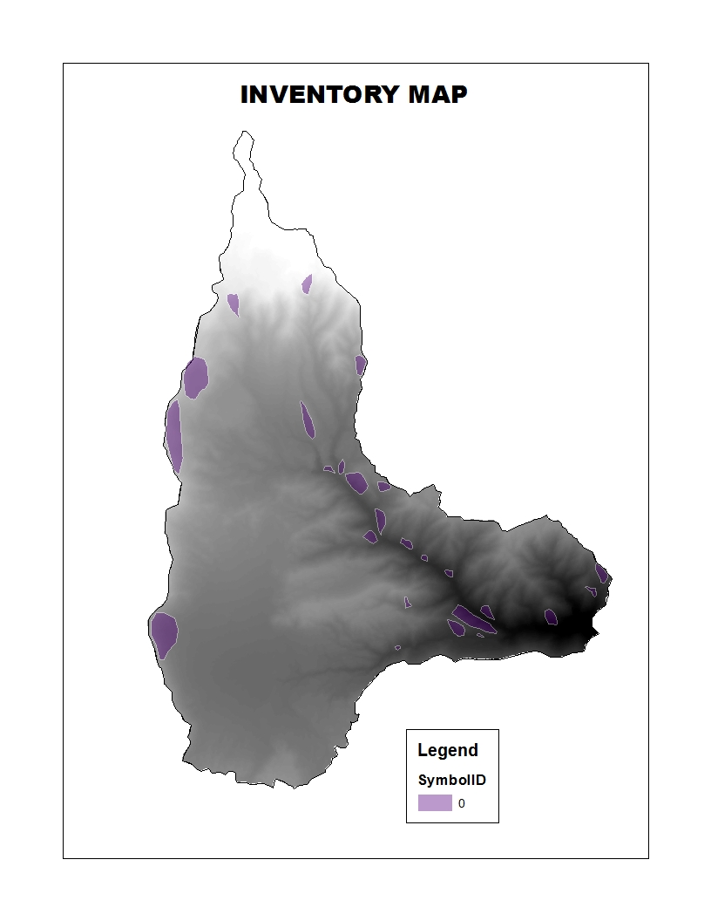

Slide 4
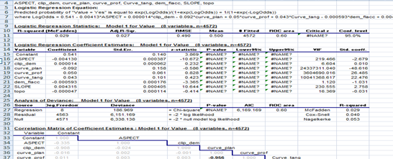
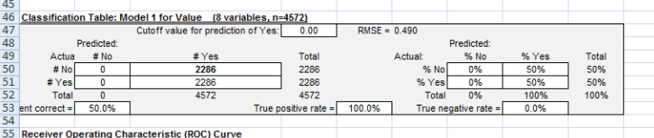
LOGISTIC REGRESSION CALCULATION TABLE
UNFORTUNATELY, THE ACCURACY OF THE PREDICTION COULD
NOT BE ESTIMATED DUE TO AN ERROR THAT OCCURRED WHILE PROCESSING
THE NON LANDSLIDE VALUES.

Slide 5
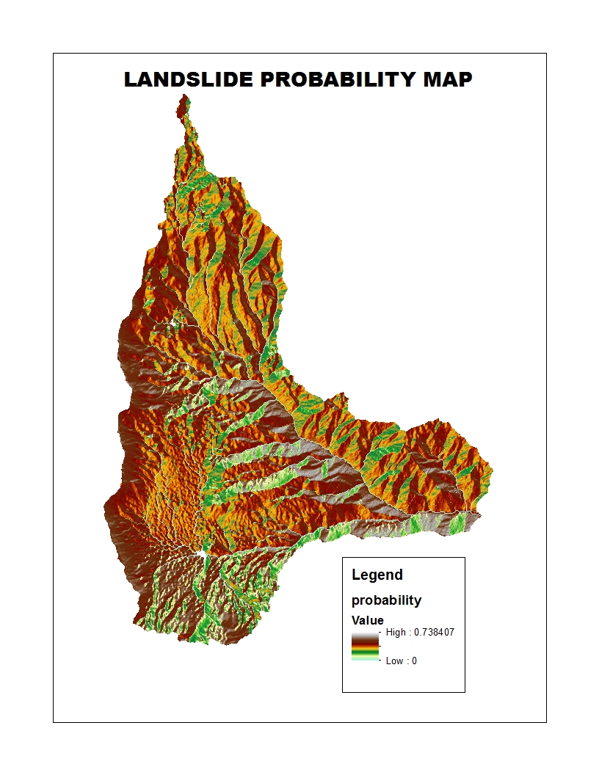

Slide 6
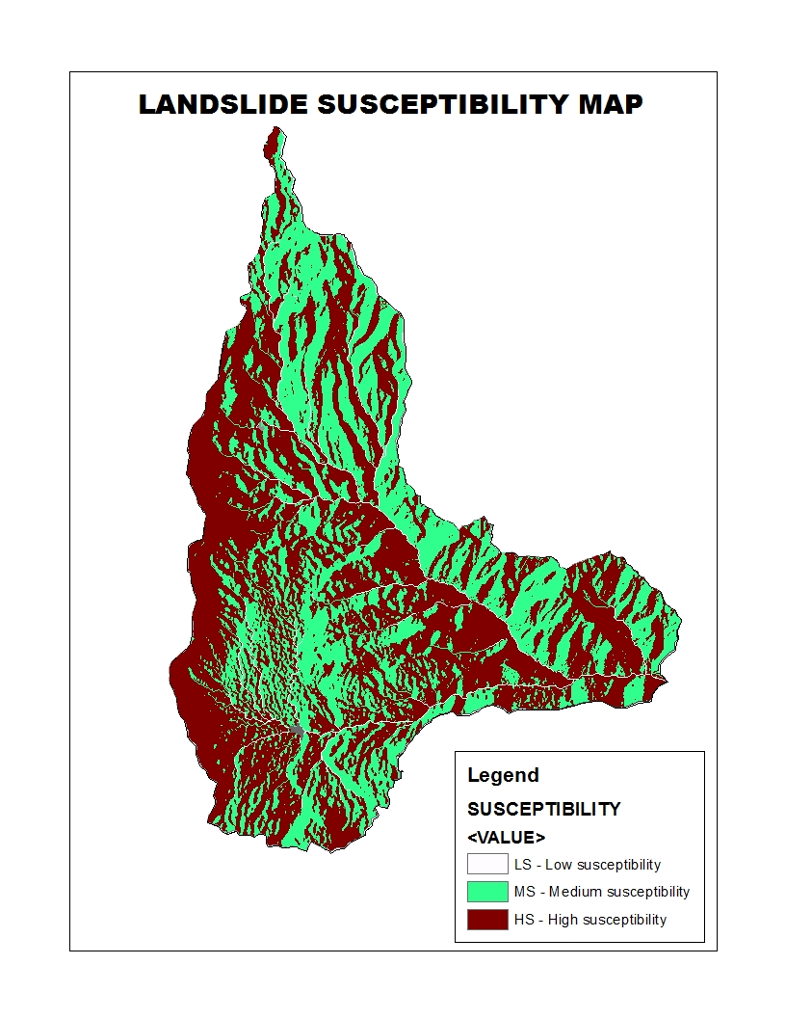

Slide 7
ANALYSIS AND INTERPRETATION DATA
8 landslide causing factors was used in this Exercise which are
Elevation, slope, curvature ( plan, profile and tangent), aspect,
topographic wetness index, flow accumulation. The most important factors
Are topographical and hydrological data because they are easy to obtain
And they give good results.
The final map has a probability from 0 to 0.738, this shows that at 0,we have Little or no landslide
while at 0.738 there is a high chance of landslide.
Geological parameters greatly influence the occurrence of landslides, because lithological and structural variations often lead to a difference in strength and permeability of rocks and soils

